Slide 1
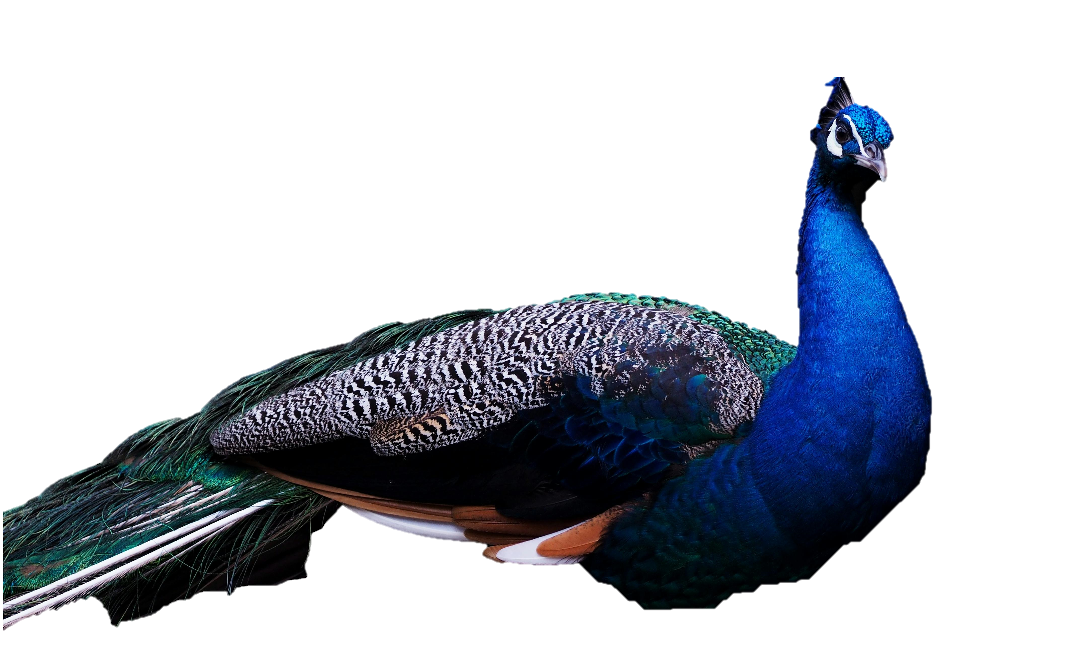
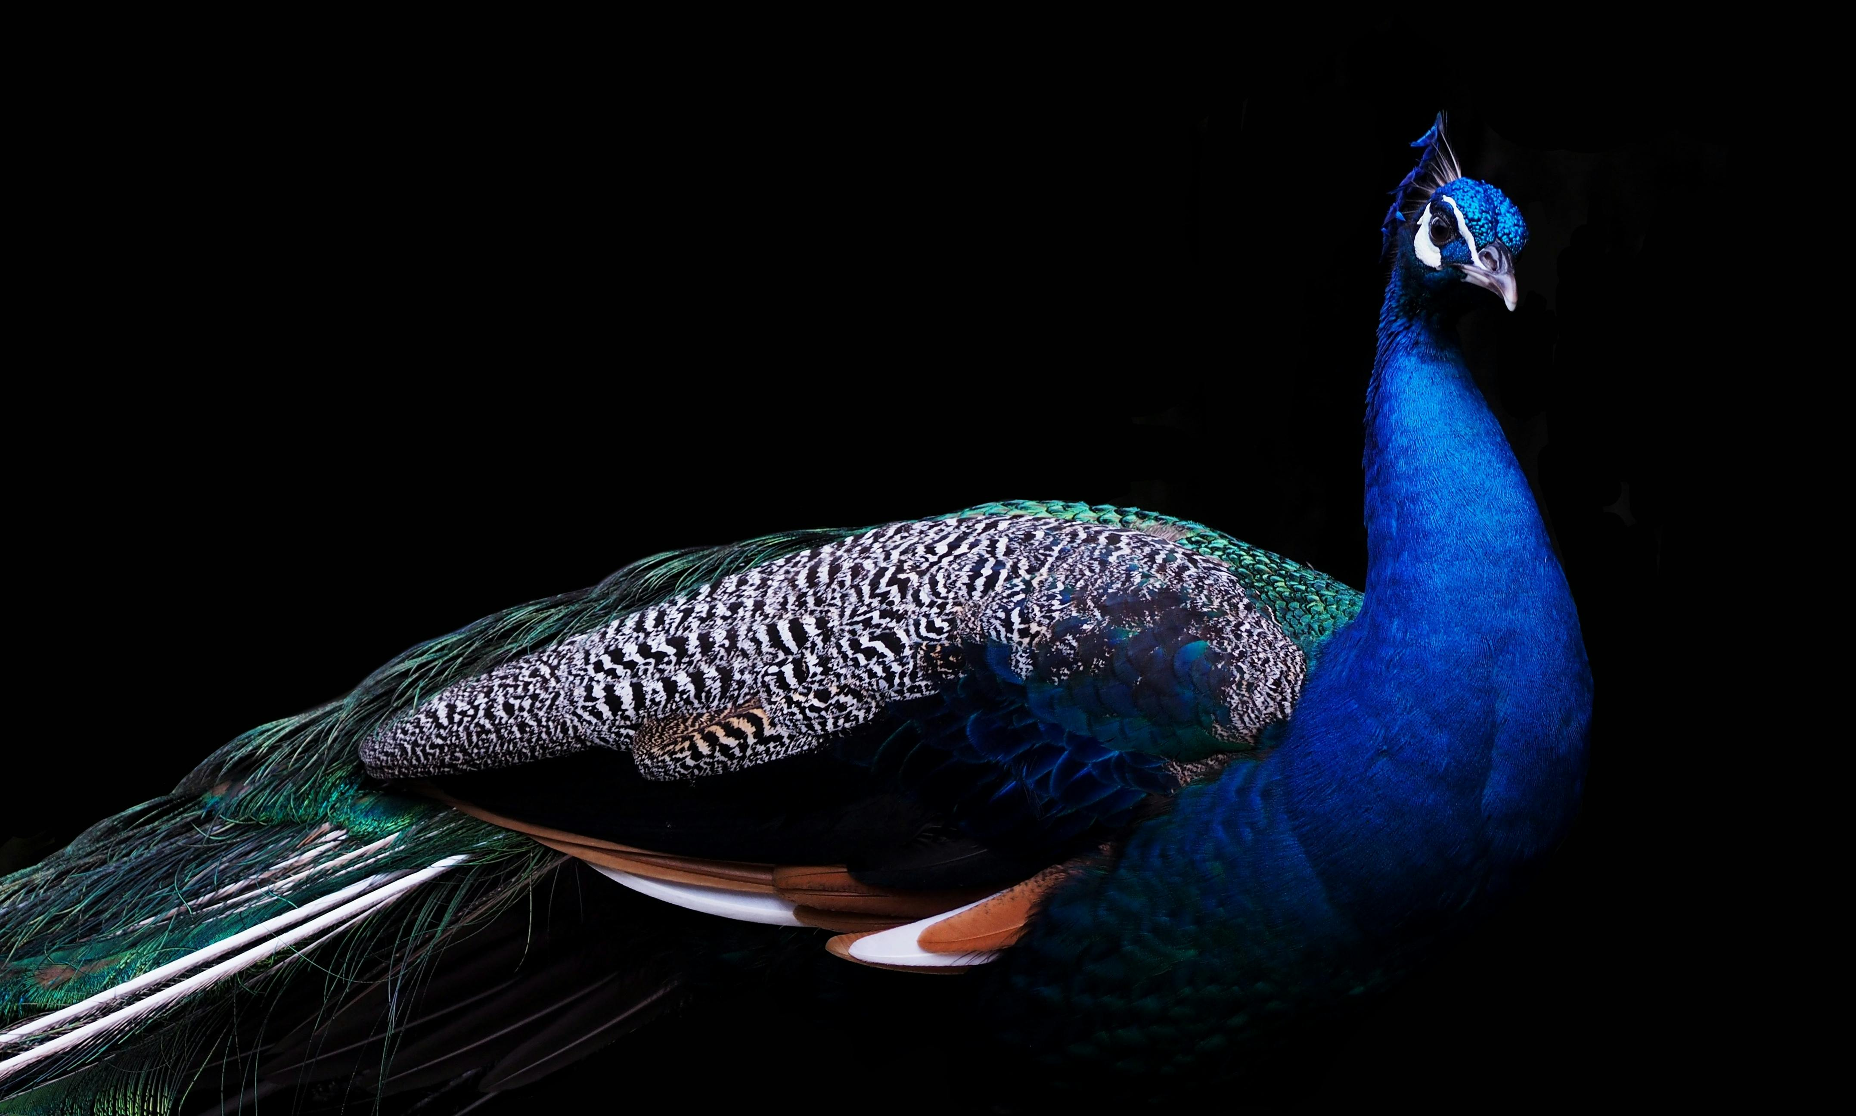
WILDLIFE CLASSIFIER

Slide 2
WILDLIFE CLASSIFIER
Supratim Saha – E23CSEU0525 Sambhav Jain – E23CSEU0577

Slide 3

INTRODUCTION
Biodiversity is under constant threat from habitat destruction, climate change, and poaching, making wildlife monitoring and conservation critical. Traditional methods like field surveys and manual annotations are not only labor-intensive but also prone to significant errors. Deep learning offers a scalable and automated solution to these challenges, with Convolutional Neural Networks (CNNs) demonstrating remarkable success in feature extraction and image classification tasks.
This project aims to develop a robust wildlife image classification system using the EfficientNetB3 architecture to accurately classify images of 90 animal species. By leveraging advanced preprocessing techniques and data augmentation, the model achieves high accuracy and generalizability across diverse animal classes. The results contribute to ecological monitoring and conservation efforts, enabling efficient and accurate identification of species in real-world applications.

Slide 4
Convolutional Neural Networks (CNNs) are a specialized type of deep learning algorithm highly effective for image classification tasks. They process input images by automatically extracting hierarchical features, making them ideal for tasks involving complex patterns and textures. The architecture of a CNN typically includes three main components: convolutional layers, pooling layers, and fully connected layers.
Convolutional layers apply filters to detect features like edges, textures, and shapes by sliding across the image, creating feature maps. Activation functions such as ReLU introduce non-linearity, enabling the network to learn complex patterns. Pooling layers, such as max-pooling, downsample the feature maps, reducing spatial dimensions and computational complexity while retaining essential information. Finally, the feature maps are flattened and passed to fully connected layers, which use a softmax function to classify the input into distinct categories.
CNNs excel in handling large datasets, achieving high accuracy through automatic feature extraction and hierarchical pattern learning. Pre-trained models like EfficientNet and ResNet further enhance efficiency by enabling transfer learning. These models find applications in wildlife classification, object detection, medical imaging, and beyond, making CNNs a cornerstone of modern computer vision tasks.

Slide 5
RESNET
VGG16
EFFICIENTNET
Description: ResNet introduced the concept of residual learning to address the degradation problem in deep networks, where adding more layers can worsen performance due to vanishing gradients.
Description:
VGG16 is a deep convolutional neural network known for its simplicity and effectiveness in image classification tasks. It was introduced by the Visual Geometry Group (VGG) at the University of Oxford.
Description: EfficientNet is a family of CNN architectures designed to optimize both accuracy and computational efficiency. It scales width, depth, and resolution in a balanced manner using a compound scaling method.
Overview of CNN-based Image Classification methods
Key Features:
Uses "skip connections" or residual blocks to bypass layers, allowing gradients to flow directly.
Available in various depths, such as ResNet50, ResNet101, etc.
Focuses on learning residual mappings instead of direct mappings.
Key Features:
Composed of 16 layers (13 convolutional and 3 fully connected).
Uses small 3x3 filters with a stride of 1 for feature extraction.
Employs max-pooling layers for downsampling and ReLU activation for non-linearity.
Key Features:
Introduced by Google AI in 2019, EfficientNet achieves state-of-the-art performance with fewer parameters.
Uses mobile inverted bottleneck convolution (MBConv) for efficient feature extraction.
EfficientNet variants (B0 to B7) allow for scaling depending on resource availability.

Slide 6
VGG16
RESNET
EFFICIENTNET
Description:
VGG16 is a deep convolutional neural network known for its simplicity and effectiveness in image classification tasks. It was introduced by the Visual Geometry Group (VGG) at the University of Oxford.
Description: ResNet introduced the concept of residual learning to address the degradation problem in deep networks, where adding more layers can worsen performance due to vanishing gradients.
Description: EfficientNet is a family of CNN architectures designed to optimize both accuracy and computational efficiency. It scales width, depth, and resolution in a balanced manner using a compound scaling method.
Key Features:
Composed of 16 layers (13 convolutional and 3 fully connected).
Uses small 3x3 filters with a stride of 1 for feature extraction.
Employs max-pooling layers for downsampling and ReLU activation for non-linearity.
Key Features:
Uses "skip connections" or residual blocks to bypass layers, allowing gradients to flow directly.
Available in various depths, such as ResNet50, ResNet101, etc.
Focuses on learning residual mappings instead of direct mappings.
Key Features:
Introduced by Google AI in 2019, EfficientNet achieves state-of-the-art performance with fewer parameters.
Uses mobile inverted bottleneck convolution (MBConv) for efficient feature extraction.
EfficientNet variants (B0 to B7) allow for scaling depending on resource availability.

Slide 7
VGG16
EFFICIENTNET
RESNET
Description:
VGG16 is a deep convolutional neural network known for its simplicity and effectiveness in image classification tasks. It was introduced by the Visual Geometry Group (VGG) at the University of Oxford.
Description: EfficientNet is a family of CNN architectures designed to optimize both accuracy and computational efficiency. It scales width, depth, and resolution in a balanced manner using a compound scaling method.
Description: ResNet introduced the concept of residual learning to address the degradation problem in deep networks, where adding more layers can worsen performance due to vanishing gradients.
We used EfficientNetB3 for its efficiency and high accuracy in image classification.
Key Features:
Composed of 16 layers (13 convolutional and 3 fully connected).
Uses small 3x3 filters with a stride of 1 for feature extraction.
Employs max-pooling layers for downsampling and ReLU activation for non-linearity.
Key Features:
Introduced by Google AI in 2019, EfficientNet achieves state-of-the-art performance with fewer parameters.
Uses mobile inverted bottleneck convolution (MBConv) for efficient feature extraction.
EfficientNet variants (B0 to B7) allow for scaling depending on resource availability.
Key Features:
Uses "skip connections" or residual blocks to bypass layers, allowing gradients to flow directly.
Available in various depths, such as ResNet50, ResNet101, etc.
Focuses on learning residual mappings instead of direct mappings.

Slide 8
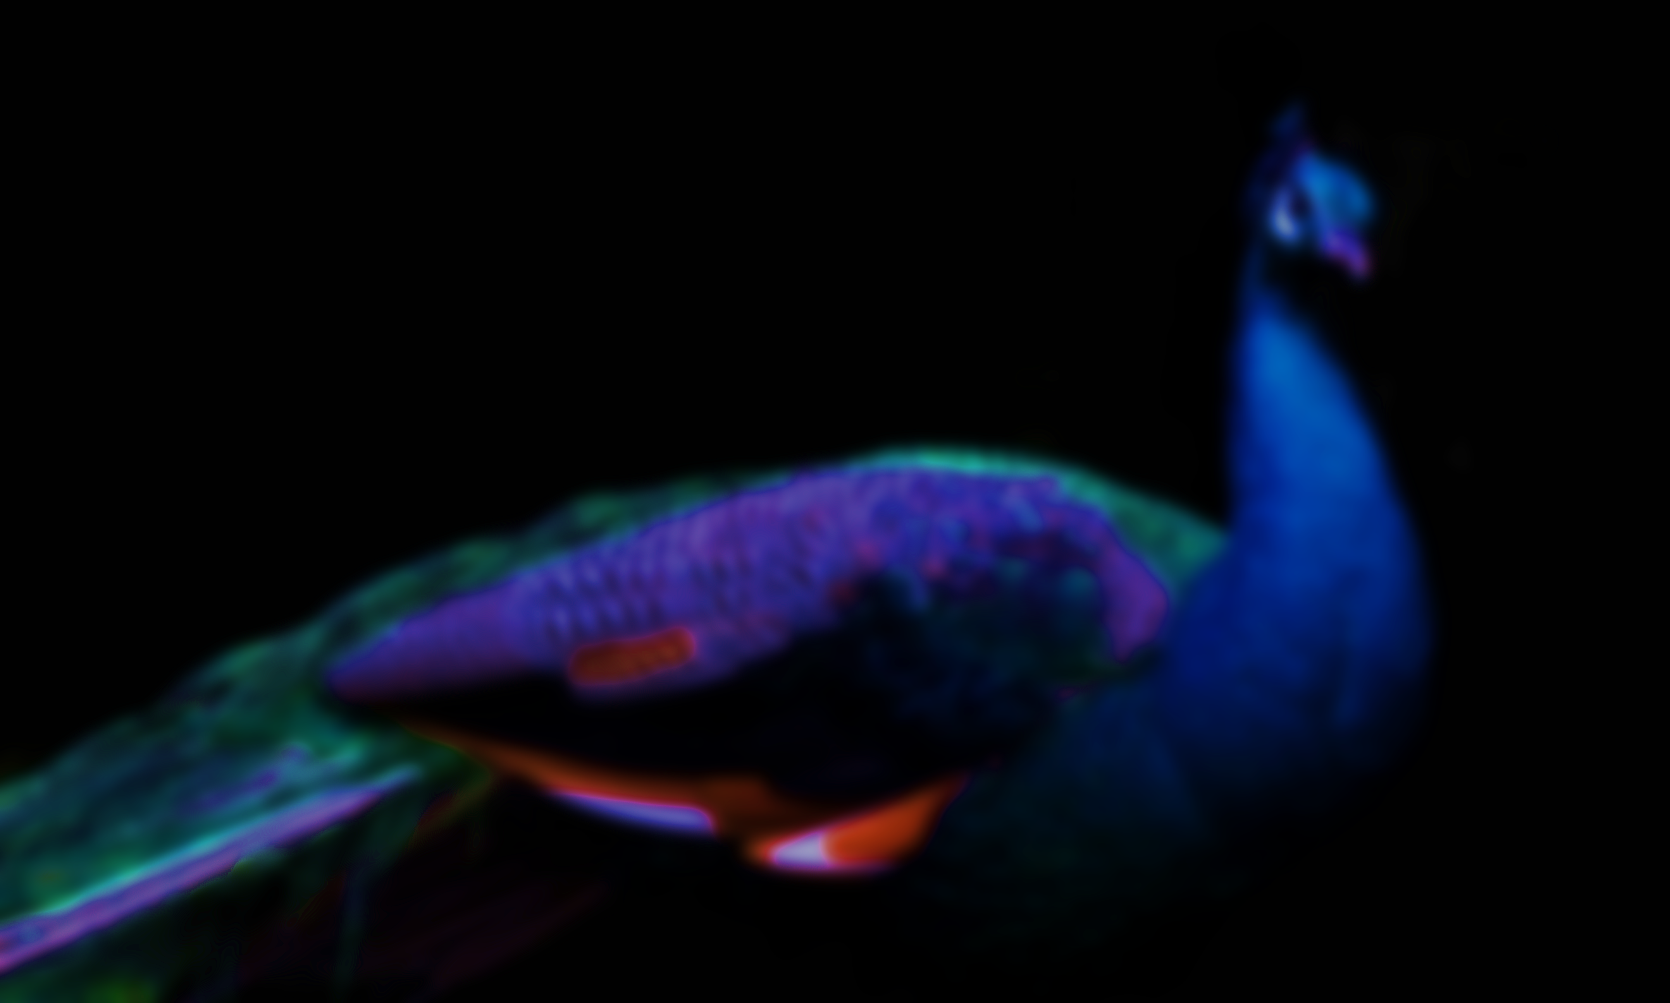
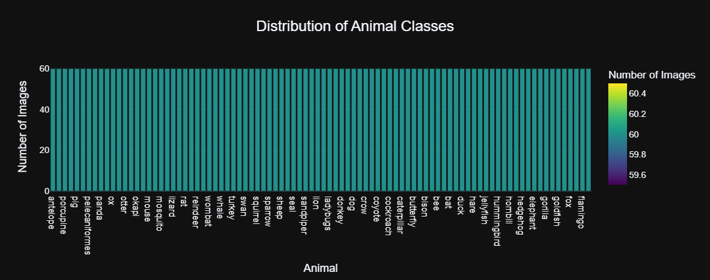
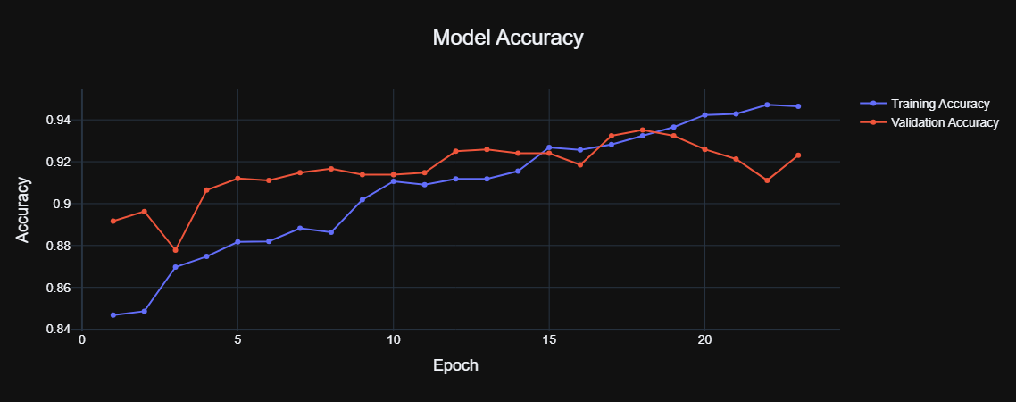
What We Did in the Code :
Data Preprocessing
Resized all images to 224×224 pixels for consistency with the EfficientNetB3 model.
Normalized pixel values to the range [0,1][0, 1][0,1], speeding up the training process.
Data Augmentation
Applied transformations such as rotation, width/height shifts, zoom, and horizontal flips.
Enhanced dataset variability to improve generalization and reduce overfitting.
Model Architecture and Training
Used EfficientNetB3, a pre-trained CNN model, optimized for image classification tasks.
Added pooling, dropout, and dense layers to adapt the model to the 90-class dataset.
Implemented early stopping to halt training when validation accuracy plateaued.
Reduced the learning rate dynamically to improve model convergence during later epochs.
Evaluation and Performance
Achieved a training accuracy of 98% and a validation accuracy of 96%.
Generated a classification report with detailed metrics (precision, recall, F1-score) for all 90 classes.
Visualized results using a confusion matrix, highlighting minimal misclassifications between similar animal classes.
Visualization and Analysis
Plotted training and validation accuracy/loss curves to monitor the model’s learning progress.
Analyzed prediction distributions and errors to identify challenging classes and potential improvements.
VGG16
RESNET
EFFICIENTNET
Description: ResNet introduced the concept of residual learning to address the degradation problem in deep networks, where adding more layers can worsen performance due to vanishing gradients.
Description:
VGG16 is a deep convolutional neural network known for its simplicity and effectiveness in image classification tasks. It was introduced by the Visual Geometry Group (VGG) at the University of Oxford.
Description: EfficientNet is a family of CNN architectures designed to optimize both accuracy and computational efficiency. It scales width, depth, and resolution in a balanced manner using a compound scaling method.
Key Features:
Uses "skip connections" or residual blocks to bypass layers, allowing gradients to flow directly.
Available in various depths, such as ResNet50, ResNet101, etc.
Focuses on learning residual mappings instead of direct mappings.
Key Features:
Composed of 16 layers (13 convolutional and 3 fully connected).
Uses small 3x3 filters with a stride of 1 for feature extraction.
Employs max-pooling layers for downsampling and ReLU activation for non-linearity.
Key Features:
Introduced by Google AI in 2019, EfficientNet achieves state-of-the-art performance with fewer parameters.
Uses mobile inverted bottleneck convolution (MBConv) for efficient feature extraction.
EfficientNet variants (B0 to B7) allow for scaling depending on resource availability.

Slide 9
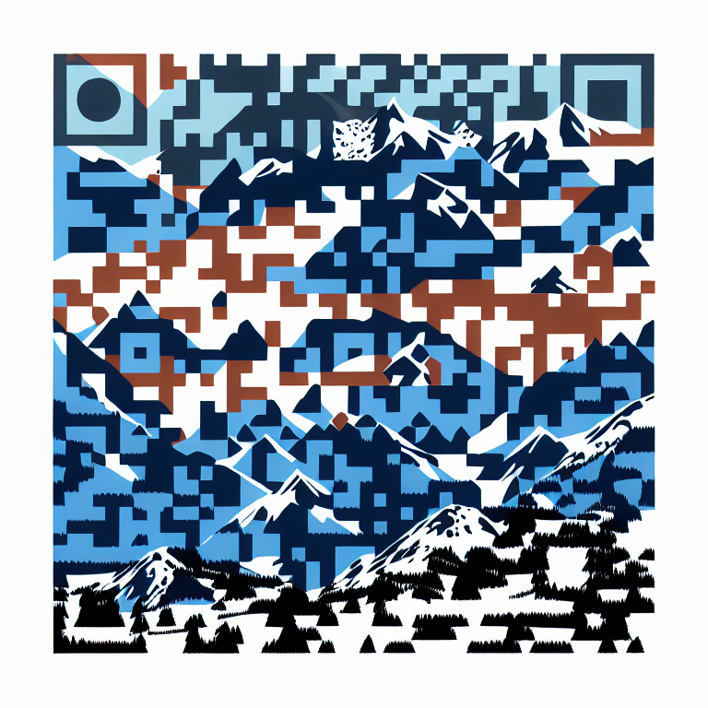
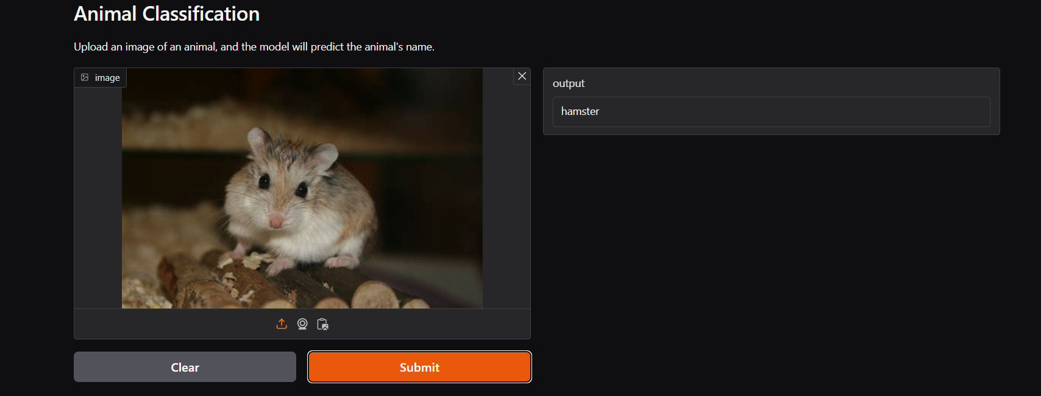
VGG16
RESNET
EFFICIENTNET
Description: ResNet introduced the concept of residual learning to address the degradation problem in deep networks, where adding more layers can worsen performance due to vanishing gradients.
Description:
VGG16 is a deep convolutional neural network known for its simplicity and effectiveness in image classification tasks. It was introduced by the Visual Geometry Group (VGG) at the University of Oxford.
Description: EfficientNet is a family of CNN architectures designed to optimize both accuracy and computational efficiency. It scales width, depth, and resolution in a balanced manner using a compound scaling method.
Key Features:
Uses "skip connections" or residual blocks to bypass layers, allowing gradients to flow directly.
Available in various depths, such as ResNet50, ResNet101, etc.
Focuses on learning residual mappings instead of direct mappings.
Key Features:
Composed of 16 layers (13 convolutional and 3 fully connected).
Uses small 3x3 filters with a stride of 1 for feature extraction.
Employs max-pooling layers for downsampling and ReLU activation for non-linearity.
Key Features:
Introduced by Google AI in 2019, EfficientNet achieves state-of-the-art performance with fewer parameters.
Uses mobile inverted bottleneck convolution (MBConv) for efficient feature extraction.
EfficientNet variants (B0 to B7) allow for scaling depending on resource availability.
The animal classification model has been effectively deployed using Gradio and hosted live on Hugging Face Spaces to provide an intuitive and accessible interface for users. Gradio was utilized to create a lightweight and user-friendly web application that allows users to interact with the model seamlessly. The application enables users to upload an image of an animal via drag-and-drop or by clicking to upload. Once the image is submitted, the model processes it in real-time and predicts the animal's name with high accuracy. Additional features include options to clear the inputs and reset the application for further usage.
The deployment on Hugging Face Spaces ensures that the application is scalable, reliable, and accessible worldwide. Hugging Face's robust infrastructure allows for efficient hosting of machine learning models and applications, making it easy for users to test and integrate the model into their workflows.
The entire codebase, including preprocessing steps, model training, and deployment scripts, is publicly available on GitHub. This ensures transparency, reproducibility, and the ability for other developers or researchers to build upon the work. The use of Gradio for the front-end and Hugging Face for hosting has made the deployment process efficient, cost-effective, and user-focused. This deployed application bridges the gap between research and real-world usability, providing a practical tool for wildlife monitoring, conservation efforts, and educational purposes.

Slide 10
VGG16
RESNET
EFFICIENTNET
Description: ResNet introduced the concept of residual learning to address the degradation problem in deep networks, where adding more layers can worsen performance due to vanishing gradients.
Description:
VGG16 is a deep convolutional neural network known for its simplicity and effectiveness in image classification tasks. It was introduced by the Visual Geometry Group (VGG) at the University of Oxford.
Description: EfficientNet is a family of CNN architectures designed to optimize both accuracy and computational efficiency. It scales width, depth, and resolution in a balanced manner using a compound scaling method.
Thank you
Key Features:
Uses "skip connections" or residual blocks to bypass layers, allowing gradients to flow directly.
Available in various depths, such as ResNet50, ResNet101, etc.
Focuses on learning residual mappings instead of direct mappings.
Key Features:
Composed of 16 layers (13 convolutional and 3 fully connected).
Uses small 3x3 filters with a stride of 1 for feature extraction.
Employs max-pooling layers for downsampling and ReLU activation for non-linearity.
Key Features:
Introduced by Google AI in 2019, EfficientNet achieves state-of-the-art performance with fewer parameters.
Uses mobile inverted bottleneck convolution (MBConv) for efficient feature extraction.
EfficientNet variants (B0 to B7) allow for scaling depending on resource availability.

